Slide 1
Introduction to
Databricks Repos
Notes:
Databricks is always striving to simplify the developer experience on our platform. With the introduction of Databricks Repos, users can now configure and use repository-level integration with a number of Git providers, making it easier than ever to follow development best practices while working on Databricks.

Slide 2
What is Repos?
Notes:
What exactly is Repos?

Slide 3
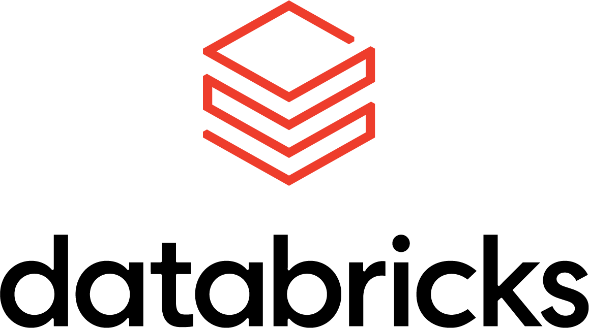
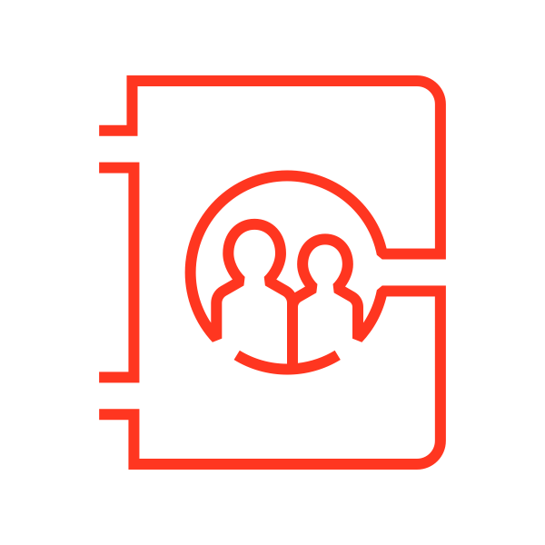


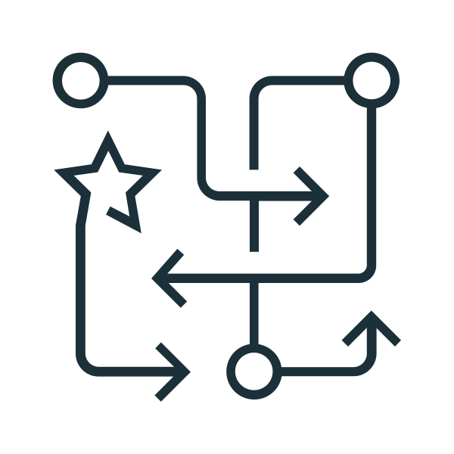




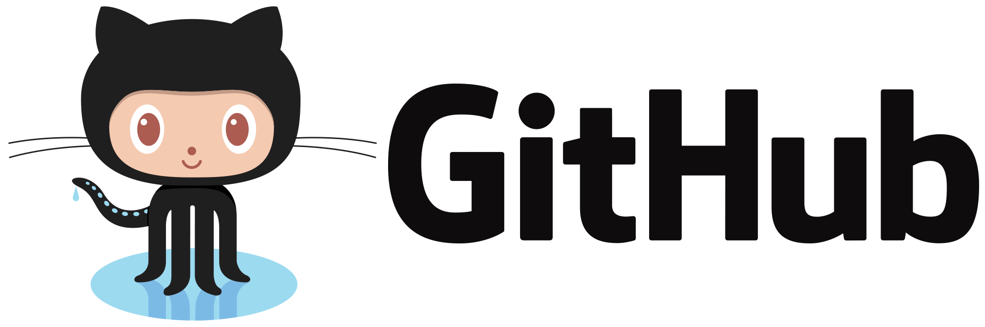
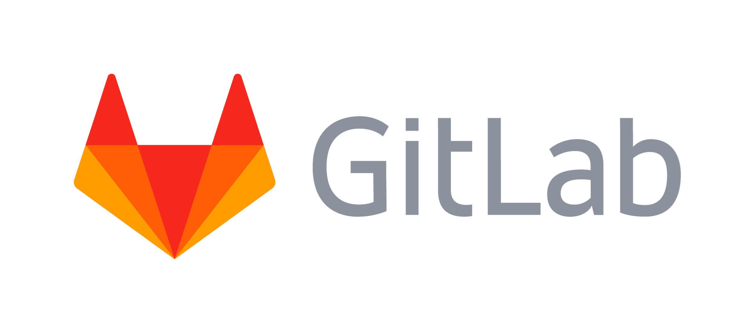


CI/CD Integration
Development / Experimentation
Production Jobs
▲
▼
Git / CI/CD Systems
Version
Review
Test
Supported Git Providers
Notes:
Repos greatly expands Git support within the Databricks platform, making it easier than ever to move from notebook-based development to production jobs.
Because Databricks Repos supports many of the most popular Git providers, teams can continue to use their existing testing and deployment tools will minimal changes to their overall workflow.

Slide 4
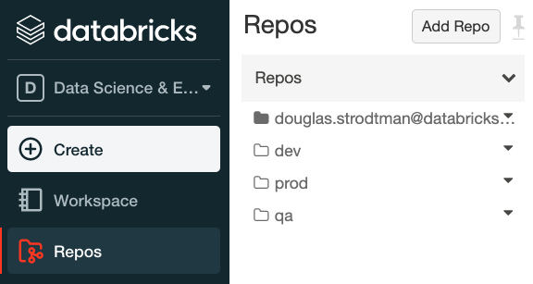
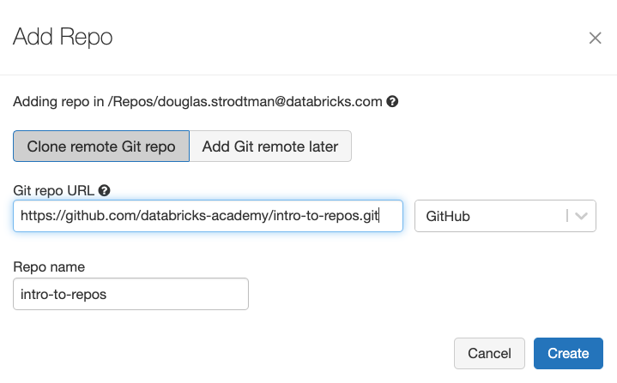
Notes:
Repos is an extension of the Databricks Data Science & Engineering workspace.
It maintains the pattern of private directories for individual users or shared directories with customize access controls.
What it adds is a simple UI for connecting to a remote Git repository, enabling project-level control over Databricks notebooks.

Slide 5
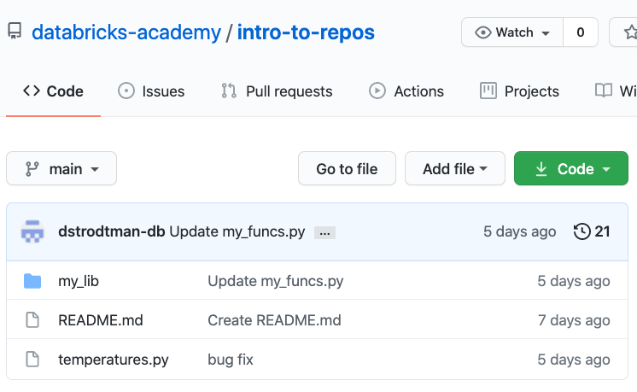
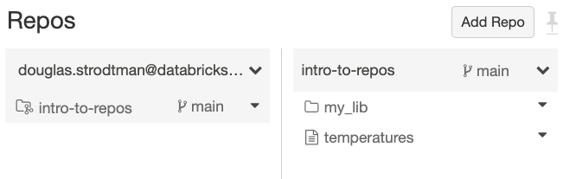
Notes:
Notebooks and directories within the remote repository will be synced back to the workspace.
This functionality makes it easier for more users to leverage the power of Git in their development processes without the workarounds necessary in previous iterations of the Databricks platform.
Repos adds support to Databricks for branching and commit comments, making it easy to push changes back to your remote repository and kick off the next step in your development and deployment lifecycle.

Slide 6
Security Features
Notes:
Databricks Repos has a number of security features to ensure that code is protected.

Slide 7
Git Authentication
Git credentials are tied to users
Account Icon > User Settings
User Settings > Git Integration tab
Follow the instructions for integration with Git provider
Notes:
Databricks will manage Git credentials at the User level, meaning that even if an individual can see a repository, they will not be able to commit changes unless they have proper credentials.
Authentication uses personal access tokens and account usernames to validate identity.
Later, we’ll see the process for linking a Github account.
Note that Public Git repositories can be pulled into a Repo without configuring authentication, but that a user will not be able to commit changes back to a remote repository without configuring valid credentials.
For private Git repositories, a PAT and username is required to pull repositories as well.

Slide 8
Enterprise Git Support
Before
Control Plane
Often not acceptable by customers
Account
▲
▼
Customer Account
Data Plane
Enterprise
Git Server
After
Control Plane
Account
▲
▼
Data Plane
Enterprise
Git Server
Customer Account
Proxy
Notes:
As part of the preview of Databricks Repos, support for enterprise Git servers has also been turned on in private preview.
Rather than forcing customers to directly connect the Databricks control plane to their private Git servers, synchronization is handled by proxying through an active driver in the customer account.
Because most enterprise Git servers have customized security permissions, a workspace admin will need to follow detailed onboarding instructions to configure this service for all users. Databricks customers should contact their account representative to learn more about this configuration.

Slide 9
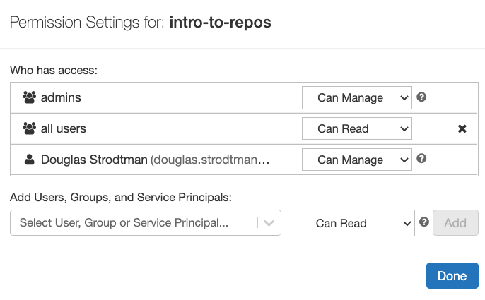
Access Control Lists
Notes:
Once imported, repos use ACLs similar to how they are applied to directories elsewhere in the workspace.
Admins and individuals with “manage” permissions can grant privileges to users or groups on a repository.
Privileges include (in order of least to most privileges) read, run, edit, and manage.

Slide 10
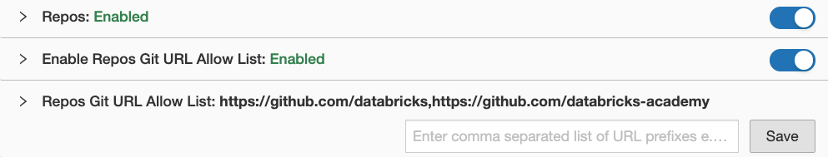
Git URL Allow List
Notes:
When Repos is first enabled, Git URL Allow List will be disabled. This means that users will be able to sync with an remote Git repository that they have proper credentials to connect to.
Custom Git URL allow lists give admins the ability to restrict which remote URLs users can push to.
The default setting when this feature is turned on is “Empty list”, which disables access to all repositories.
Note that this list is an added constraint; users will still need proper credentials for remote repositories within the allow list in order to pull and commit.

Slide 11
Notes:
Databricks Repos is still in active development, and our engineering team is very excited about the new features coming to the product later this year.
Repos already brings huge new functionality to the Databricks workspace, and makes it much easier for engineers, admins, and DevOps to work together using best practices for code management.
In the following demo, we’ll go through the basics of configuring and using Databricks Repos.

Slide 12
Recommendations
Notes:
While Repos functionality is still evolving, we have some recommendations to best leverage this feature in its current state.

Slide 13
Repos in CI/CD workflows
Development / Experimentation
Production Jobs
▲
▼
Git / CI/CD Systems
Version
Review
Test
Notes:
Repos is not meant to fully replace the tooling you currently use for CI/CD. Rather, it provides a simple to configure and use UI and API that supports the Git providers most commonly used by enterprise organizations.
As previously mentioned, admins will need to configure Databricks Repos to ensure proper security, and users will need to load their credentials. Within the Git provider, an admin or DevOps persona may also choose to configure automated actions tied to new commits.
To start a workflow, clone your remote repository into a user folder. A best practice for your work is to create a new feature branch, or select a previously created branch, instead of directly committing and pushing changes to the main branch. You can make changes, commit, and push changes in that branch.
Back in your Git provider, you’ll begin the merge process by creating a Pull Request from your version branch. Your organization likely has best practices and procedures already in place for code review and testing. Once all tests are passed and the merge into the Production branch is completed, you can use the Databricks Repos API to pull changes back into your production workspace, configuring your jobs to always run against the production branch.

Slide 14
Support for Arbitrary Files
 | Add at top of file
SQL | -- Databricks notebook source
Python | # Databricks notebook source
Notes:
At present, Databricks Repos ignores all files that aren’t Databricks notebooks (support for arbitrary files with a limited web-based IDE experience is coming soon).
SQL and Python scripts can easily be imported as single cell Databricks notebooks by editing the existing file and adding the pictured `Databricks notebook source` comment as the first line.
Databricks Repos will look for this comment when pulling changes and automatically convert the source file to a notebook.
Because this syntax is just a comment, it should not impact normal use or performance of the source file in other contexts.

Slide 15
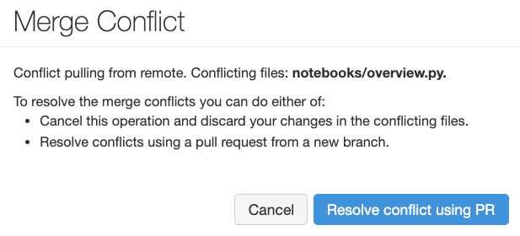
Handling Merge Conflicts
Notes:
Generally speaking, users should not encounter merge conflicts if they’re using a standard Gitflow, although users should be aware that pulling changes will clear notebook results.
In the case where a user has made a conflicting local edit on the same branch as a remote notebook, Databricks Repos will prevent the accidental overwrite of these edits when pulling from remote by providing a Merge Conflict warning.

Slide 16
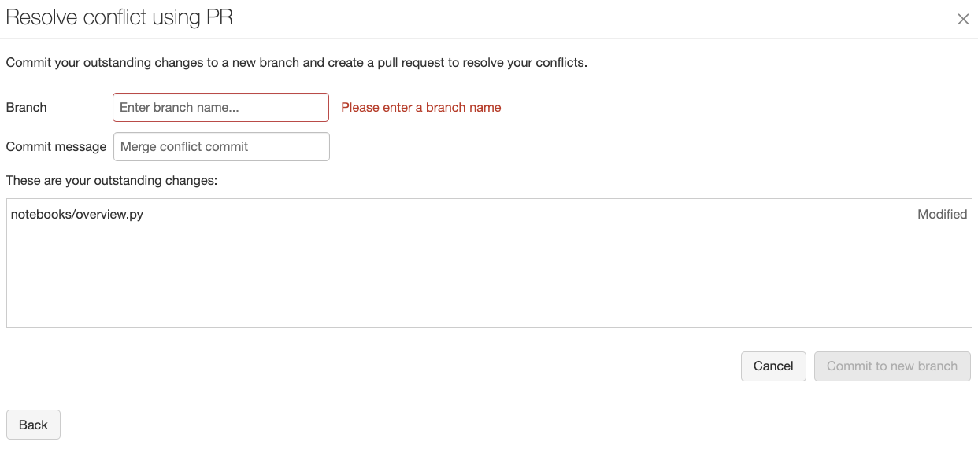
Notes:
Users can easily resolve a conflict by committing to a new branch, making sure edits are saved and synced with Git.
Full merging of multiple branches should be managed using the Git provider’s UI or command line tools.
Things do get a little more complicated if multiple collaborators are working on the same branch
If someone else pushes changes to the repository since you created the repo or performed a pull, then you would not be able to push your changes
You’d have to pull first, and potentially deal with any merge conflicts that can sometimes happen when conflicting changes are detected
Therefore pulling regularly is important, especially when multiple people are developing the same branch

Slide 17
Demo
Notes:
Two things needed:
Username (to log into your git service account)
Personal Access Token
Github → Settings → Developer Settings → Personal Access Tokens → Generate New Token
Specify purpose of this token (demo)
Expiration
Tradeoff between convenience and security
Shorter lifespan = more often need to update it
Longer lifespan = higher risk of exposure if token falls into wrong hands
Scope = repo
Generate token
This string is the token we’d need to authenticate - copy it
User Settings → Git integration → Github → now integrated Databricks with Github account
Make sure to destroy token - it is securely stored in Databricks now. Keeping an extra copy around is an added security liability
Each Databricks repo maps to a git repository, so to set a Databricks repo, let’s create a repo in Github
Create a new repository
Add README option
Copy HTTPS
Add Repo → URL → Other fields automatically populate → Create
Underlying git repository will be cloned, meaning your new repo will contain a local copy of the upstream repository
We can now start developing
It’s best practice to keep changes constrained in a development branch, especially working on development work
Following this model, once you complete your changes and they’ve been tested and approved, then merging with feature branches, or the main branch, can be handled in a more controlled manner
Create a branch called dev
Create branch → specify name (can toggle between branches)
Now begin making changes
Create a folder
Add notebook - there are a few ways to do this:
Create notebook
Import notebook
Clone an existing notebook from the workspace into the repo
Let’s push this upstream to our remote repository
You can call the repos dialogue - which itemizes the changed items
Allows us to see what’s changed in each file
Commit all changes at once
Or all changes together
This allows us to follow best practice of logically grouping commits as a collection of related changes
For each commit, provide a descriptive and concise summary. Additional details can be included in description
Things do get a little more complicated if multiple collaborators are working on the same branch
If someone else pushes changes to the repository since you created the repo or performed a pull, then you would not be able to push your changes
You’d have to pull first, and potentially deal with any merge conflicts that can sometimes happen when conflicting changes are detected
Therefore pulling regularly is important, especially when multiple people are developing the same branch
All the changes we’ve made so far are made in the dev branch
Switch to main branch - has no visibility into the changes made in the dev branch.

